Slide 1

It’s Morning Chat Time!!! Community to Cloud with F#
NDC London 2016
Don Syme =@dsyme – Microsoft Research
With assistance from @isaac_abraham, @eiriktsarpalis, @tomaspetricek and many others

Slide 2
The NDC/.NET/Microsoft World is Changing ….
Open Source
Cloud, Cloud, Cloud
Cross-platform
Bring Your Own Editor
Data Science and
Machine Learning
Heterogeneous Devices
Many Languages
Multi-contributor
Technologies
Communities

Slide 3
F# is changing…
…in subtle but important ways
F# runs on many platforms
“F# is for Windows”

Slide 4
F# is changing…
…in subtle but important ways
“F# has many contributors”
“Microsoft
makes F#”

Slide 5
F# is changing…
…in subtle but important ways
“F# is
one language with many tools”
“F# is part of
Visual Studio”

Slide 6
F# is changing…
…in subtle but important ways
Many perspectives
http://fsharp.org
One perspective
(Microsoft’s)
http://msdn.microsoft.com

Slide 7

Old think…

Slide 8
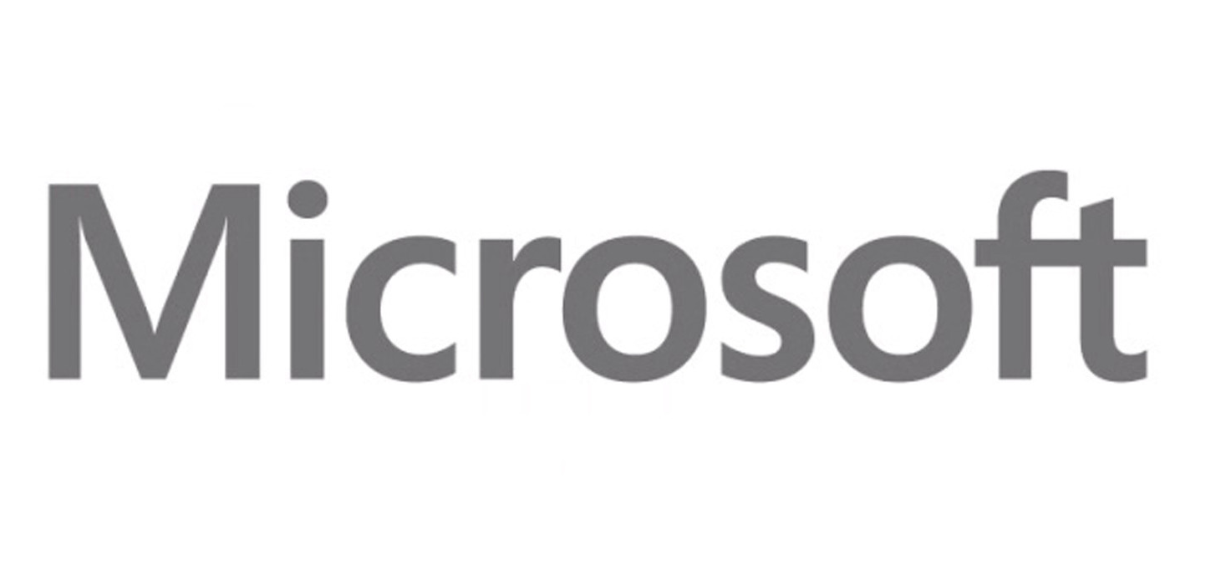


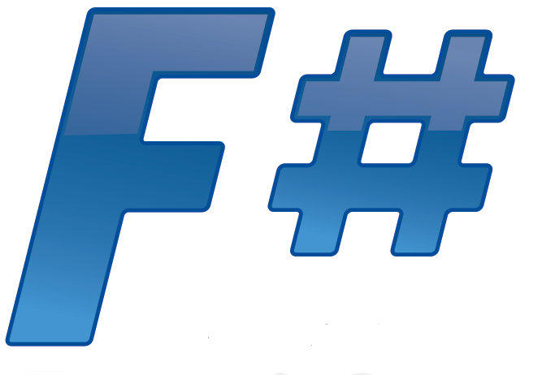





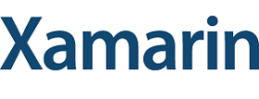
New think…
Visual Studio, .
.NET, SDKs, Tools
…
Visual F# Tools
F# Language
F# Open Source
Group
tryfsharp.org
F# Software
Foundation
F# Community
Groups
fpish.net
tryfs.org
fssnip.net
fsharpforfunandprofit.com
Xamarin Studio

Slide 9
What Kind of Language Design? What Kind of Language Community? What Kind of Language Technologies?
In a world of change…

Slide 10
The F# Community …and why it is so awesome

Slide 11
TL;DR
F# is open, cross-platform, neutral, independent
The F# Compiler Service powers many other tools
F# 4.0 now complete!
Debian packages, Docker containers and more for Linux
The F# language is accepting contributions
The F# community is very “self-empowered”
fsharp.org
The Visual F# Tools are Microsoft’s professional tools for Windows and Azure
Xamarin provide F# tools Android and iOS

Slide 12
Example #1 (power company)
We have written an application to balance the national power generation schedule … for an energy company.
...the calculation engine was written in F#.
The use of F# to address the complexity at the heart of this application clearly demonstrates a sweet spot for the language … algorithmic analysis of large data sets.
Simon Cousins (UK Power Company)

Slide 13
Example #1 (power company)
Time to Market
Efficiency
Interoperation ... Seamless. The C# programmer need never know.
Strong typing … a huge time saver...it eradicates a whole class of errors…
Exploratory programming …Working with F# Interactive allowed me to explore the solution space more effectively.
Unit testing …a joy to test. There are no complex time-dependent interactions to screw things up….
Parallelism …The functional purity ... makes it ripe for exploiting the inherent parallelism in processing vectors of data.
Code reduction… … vectors and matrices…higher order functions eat these for breakfast with minimal fuss, minimal code. Beautiful.
Lack of bugs… Functional programming can feel strange. .. once the type checker is satisfied that’s often it, it works.
Correctness
Time to Market
Time to Market
Correctness
Correctness

Slide 14
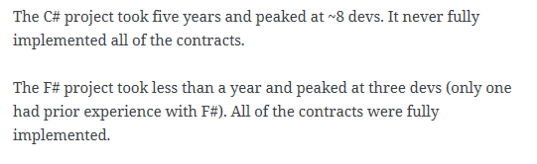
Example #1 (Simon Cousins, Energy Sector)
350,000
lines of C# OO
by offshore team
30,000
lines of robust F#, with
parallel +more features
An application to evaluate the revenue due from Balancing Services contracts in the UK energy industry
http://simontcousins.azurewebsites.net/does-the-language-you-use-make-a-difference-revisited/

Slide 15
Example #1 (Simon Cousins, Energy Sector)
Zero
bugs in deployed system
“F# is the safe choice for this project,
any other choice is too risky”
An application to evaluate the revenue due from Balancing Services contracts in the UK energy industry
http://simontcousins.azurewebsites.net/does-the-language-you-use-make-a-difference-revisited/

Slide 16
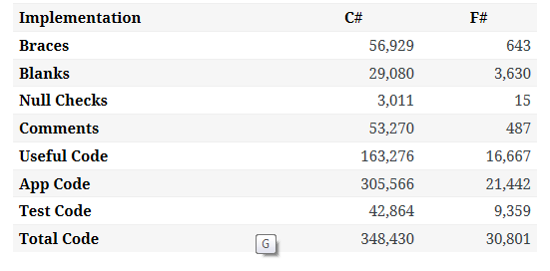

Slide 17
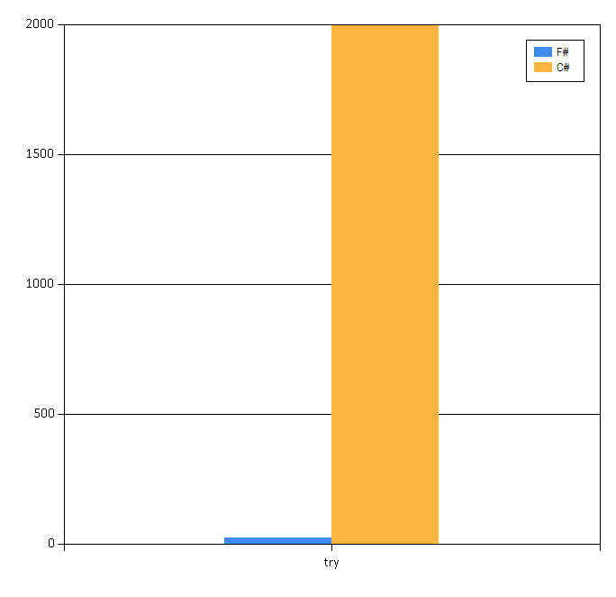

Slide 18
Example #2: F# for Cloud Social Gaming
Efficiency
F# is becoming an increasingly important part of our server side infrastructure that supports our mobile and web-based social games with millions of active users. F# first came to prominence in our technology stack in the implementation of the rules engine for our social slots games which by now serve over 700,000 unique players and 150,000,000 requests per day at peaks of several thousand requests per second.
The F# solution offers us an order of magnitude increase in productivity and allows one developer to perform the work that are performed by a team of dedicated developers on an existing Java-based solution, and is critical in supporting our agile approach and bi-weekly release cycles.
Yan Cui, Lead Server Engineer
Time to Market
fsharp.org/testimonials

Slide 19
In 18 months of community-friendly F#... We’ve come a long way!

Slide 20
The F# Compiler – 300+ Pull Requests and rising Where to Contribute? See github.com/Microsoft/visualfsharp

Slide 21
The F# Language Design Process fslang.uservoice.com

Slide 22
F# 4.0 ✔ True shift to cross-platform open engineering ✔ Long laundry list of language items ✔ Normalized core library ✔ Type providers more powerful ✔ Better debugging, tooling, performance ✔ ~20% compiler perf improvement

Slide 23
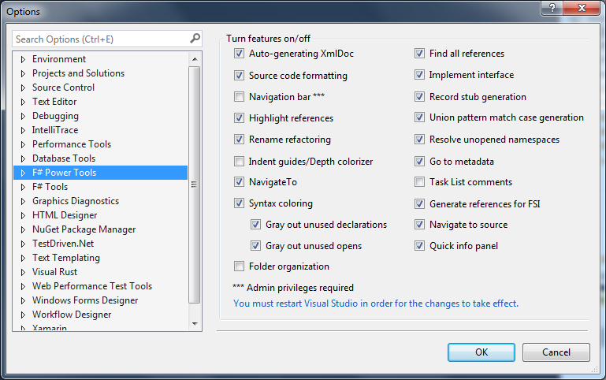
The Visual F# Power Tools
fsprojects.github.io/VisualFSharpPowerTools

Slide 24
F# for Android, iOS, Linux, Mac fsharp.org/use/android fsharp.org/use/ios fsharp.org/use/linux fsharp.org/use/mac

Slide 25

2012
Language |  | F# |  | C#
Web | ½ |  |  | ASP.NET
Big Data + Big Compute | ½ |  | ½
Actors | ½ |  | ½
Data Analytics | ½ |  | ½
GPU | ½ |  | ½
Simple Data | ½ |  | ½
Cloud Data | ½ |  | ½

Slide 26
2015, by embracing open community
Language | F#
Web | suave.io, …
Big Data + Big Compute | MBrace, …
Actors | AkkaDotNet, …
Data Analytics | fslab.org, …
GPU | Alea.GPU, …
Simple Data | FSharp.Data, …
Cloud Data | Azure, AWS, …

Slide 27
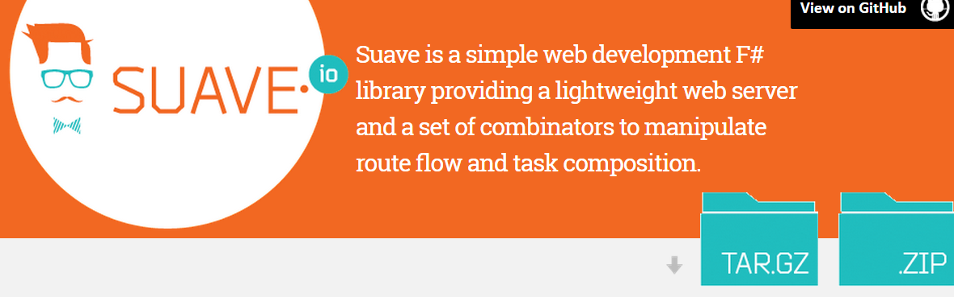
100% open source, community driven

Slide 28
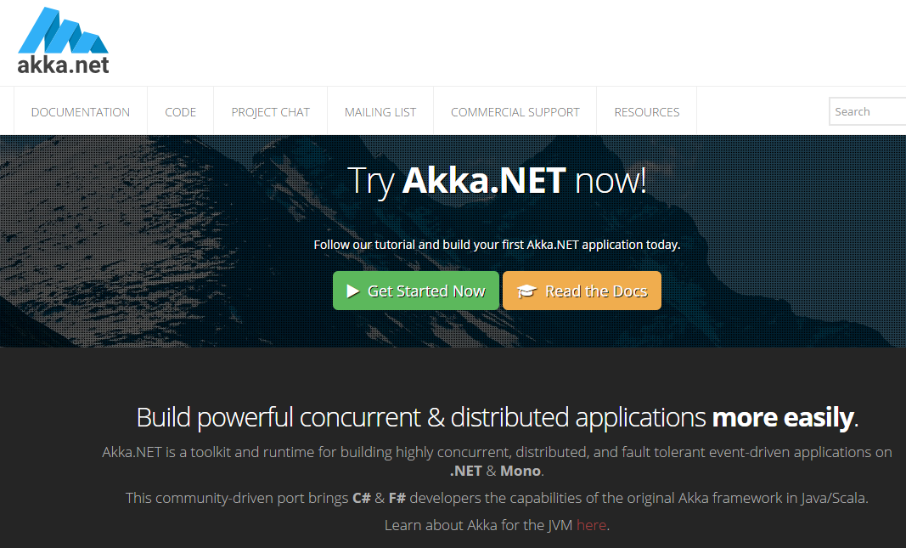
100% open source, community driven

Slide 29
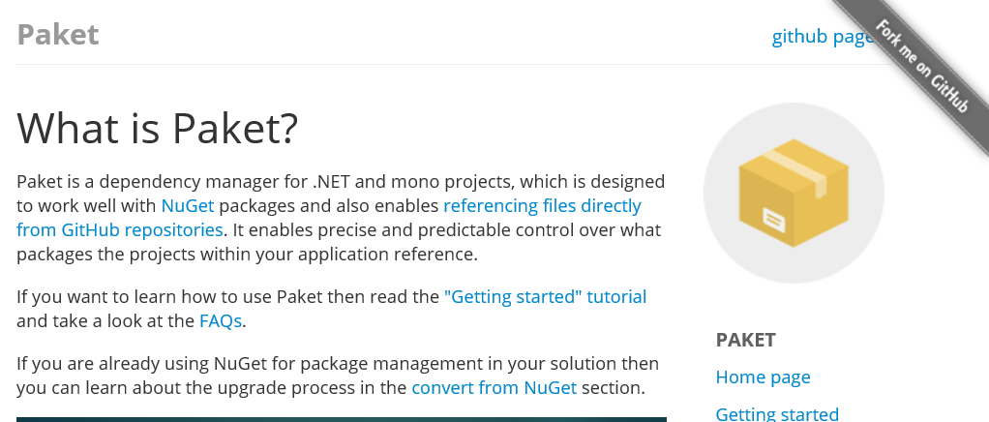
http://fsprojects.github.io/Paket/

Slide 30
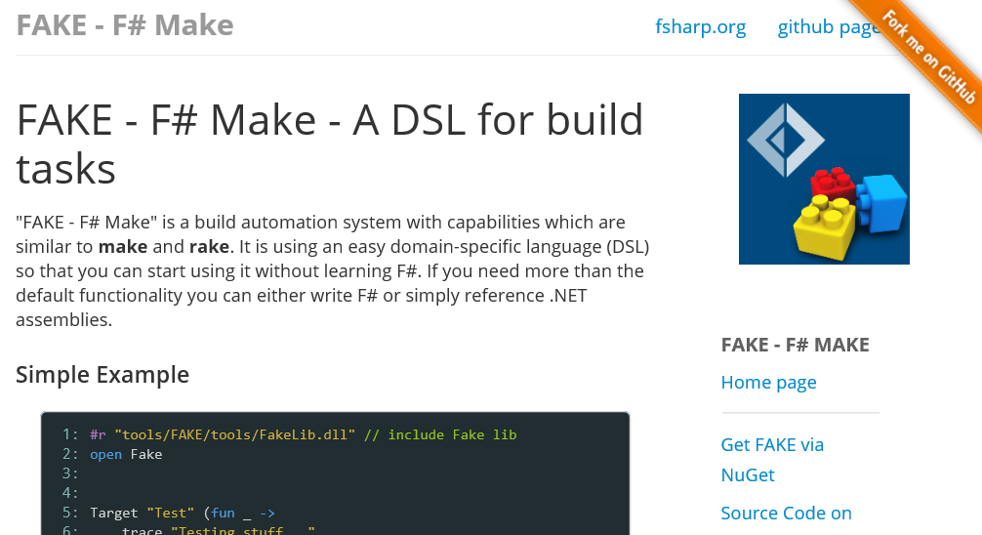
http://fsharp.github.io/FAKE/

Slide 31
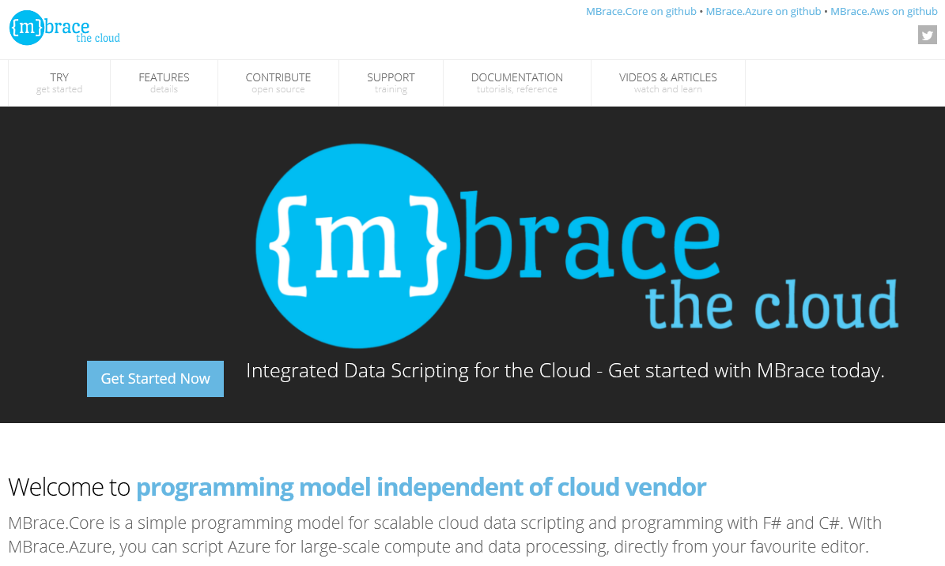
100% open source, community driven
http://mbrace.io/

Slide 32
F# for Docker? Yes! hub.docker.com/fsharp/fsharp

Slide 33
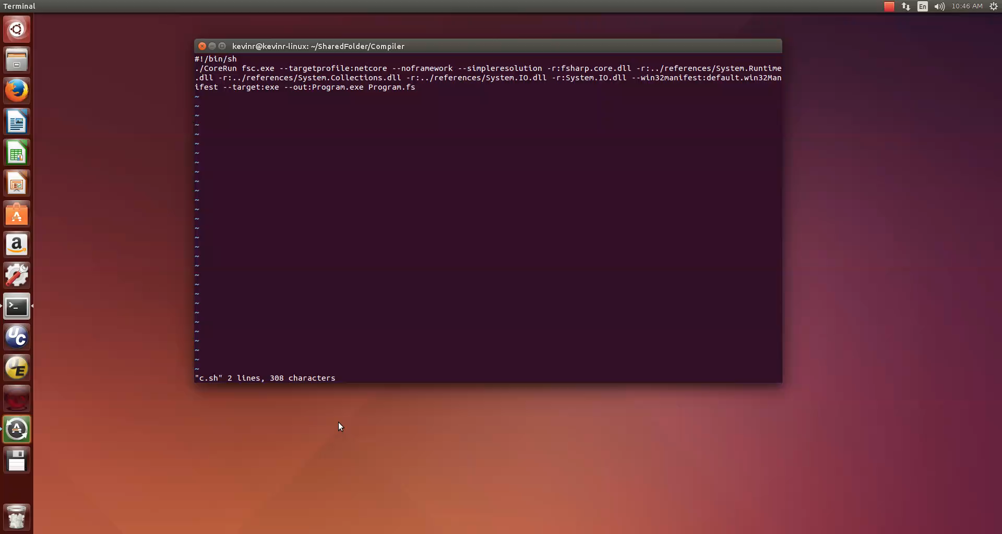
F# for CoreCLR – Yes!

Slide 34
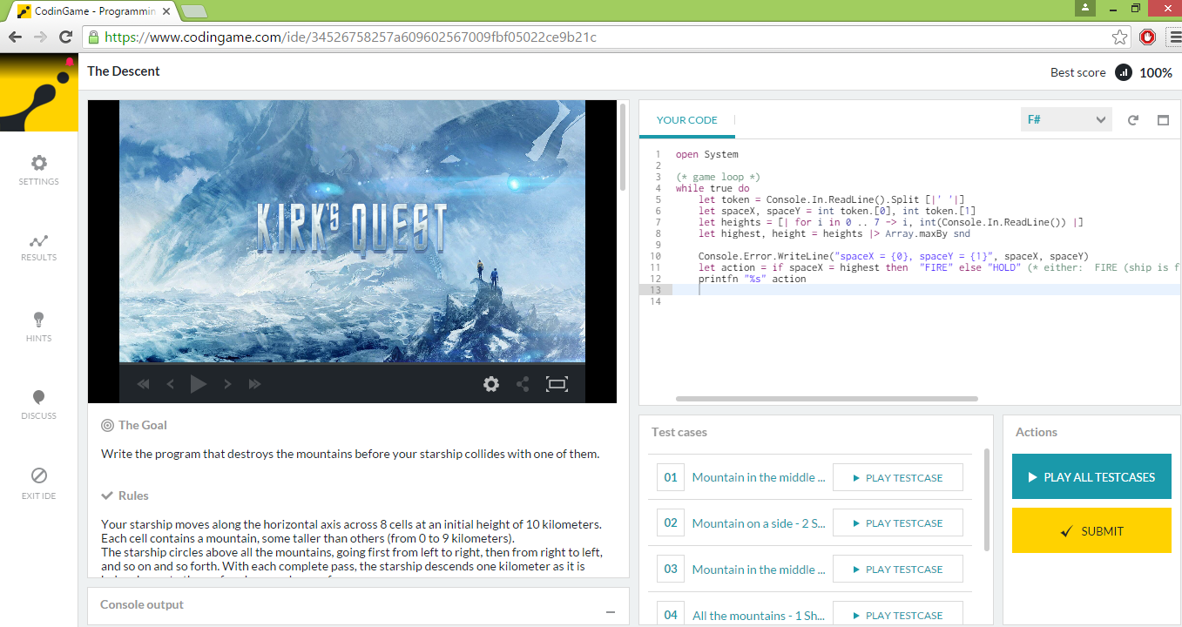
Fun @ Coding Game

Slide 35
F# for Win10 UWP Apps – “Working on it” WinDev uservoice

Slide 36
Part 2 – Cloud Simple

Slide 37
Cloud Language Design
Functional
Type-providers
Scripting
Async

Slide 38
async { … }
Shared memory
Maps to tasks

Slide 39
cloud { … }
Distribution-ready
No shared memory
Maps to cloud tasks

Slide 40
MBrace: Lean and Simple
Execution
cluster -- handle to cluster
cloud { … } -- cloud computation
local { … } -- fragment of multi-core cloud computation
Cloud.Parallel, … -- composition
Job control
cluster.CreateProcess -- start a job, asynchronously
cluster.Run -- run a job, synchronously
cluster.GetProcess(“…guid…”) -- fetch a job
job.ShowInfo()/ShowLogs() -- display a job
job.Kill() -- etc.
Data
CloudValue<T> -- handle to immutable blob in cloud storage
CloudFile -- handle to partitioned file in cloud storage
CloudQueue<T> -- handle to partitioned cloud queue
Data Flow
CloudFlow.map/groupBy/filter/sort/… -- compositional cloud-parallel data flow

Slide 41
Demo – MBrace StarterKit
Demo

Slide 42
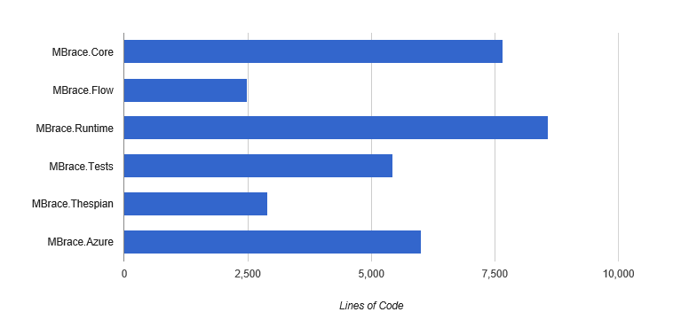
Lean and Simple

Slide 43
CloudFlow = Distributed Data Parallel F#

Slide 44
CloudFlow.OfCloudFileByLine
Partitioned data in the cloud
|> CloudFlow.map f
f
f
f
f
Your code, to ‘000s of machines, simply, transparently
|> CloudFlow.sumBy g
g
|> CloudFlow.persist

Slide 45
CloudFlow.OfHttpFilesByLine
Partitioned web inputs
http
http
http
http
|> CloudFlow.map f
f
f
f
f
|> CloudFlow.sumBy g
g
|> CloudFlow.persist

Slide 46
CloudFlow.OfCloudQueue
incremental queued inputs
|> CloudFlow.map
|> CloudFlow.averageByKey
incremental queued outputs
|> CloudFlow.toCloudQueue

Slide 47
CloudFlow.OfArray
v
local data inputs
|> CloudFlow.map
|> CloudFlow.averageByKey
|> CloudFlow.toCloudQueue

Slide 48
CloudFlow.OfArray
v
local data inputs
|> CloudFlow.map
|> CloudFlow.averageByKey
|> CloudFlow.toCloudQueue

Slide 49
Demo – UK House Prices

Slide 50
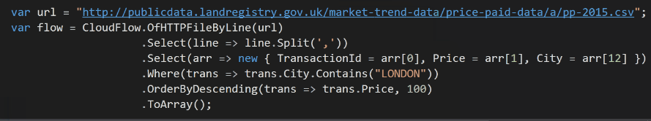
and from C# too!

Slide 51
Summary
F# community – fun, happy, creative and practical
Awesome Tech!
Suave, Docker, CoreCLR, MBrace, Akka.NET, Paket, FAKE, and much more
F# - the right design for the web and cloud
Join in the fun!

Slide 52
Possible Question & Discussion Topics!
F# Priorities for Microsoft
F#, Cross-Platform, Mono and CoreCLR
F# and Cloud
F# Priorities at Xamarin
F# Web
F# Data Science
F# Language Design Futures

Slide 53
Questions?

